Slide 1
Mental Health And Suicides In Canada
Presentation by Health Care Industry Group
Business Analytics Consulting Capstone Project (BAN 240-NAA)
Group Members:
Gurleen (112566211)
Jasmeet Kaur (107154213)
Manasi Yeole (152536207)
Pavansanjusha Gowrisetty (121944219)
Shantanu Malhotra (152156204)
Vaibhav Nitinkumar Gosai (152568200)

Slide 2
Agenda
Introduction
Analysis
Conclusion

Slide 3
Introduction
Mental illnesses had an economic cost of approximately $80 billion for the year 2021 to the Canadian healthcare and social support system
Individuals that suffer from a mental disorder have an approximately eight-fold increased risk of suicide in comparison to those without a mental health problem.
Suicide is one of the top ten causes of death in Canada

Slide 4

Problem Statement
Through this project, we aim to examine the relationship between mental health and suicides in Canada and answer the following questions:
Which age group and gender are more affected by mental health problems in Ontario?
Patients with which mental disorders are most likely to die?
What are the early signs of suicide in mental health patients?

Slide 5

Research Methodology
Secondary Data Collection
Mixed method
Pragmatic methodology

Slide 6
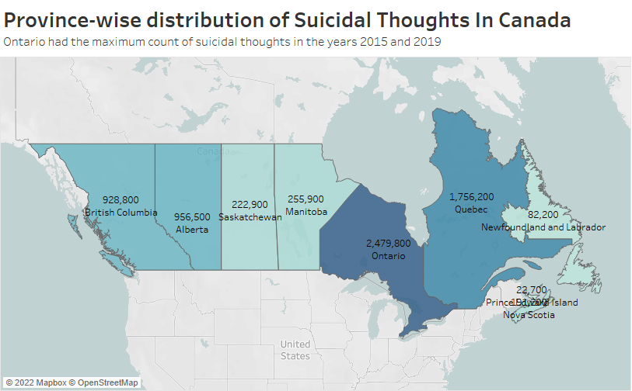

Slide 7
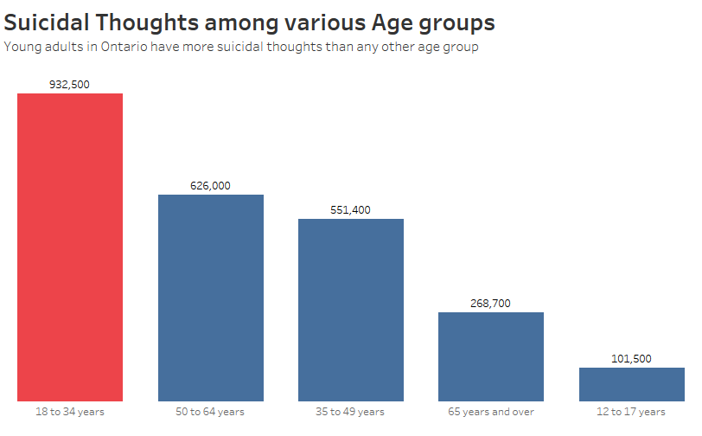
Around 1 million young adults in Ontario have suicidal thoughts.
Suicidal thoughts were observed least in teenagers.
Middle-aged people in Ontario had moderate suicidal thoughts.

Slide 8
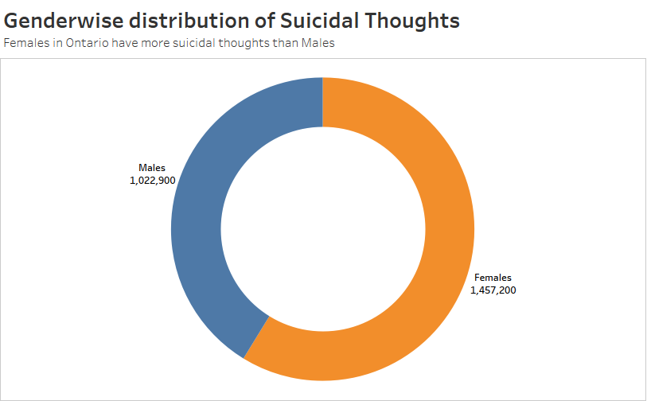
Females in Ontario recorded to have more suicidal thoughts in comparison to males.
Around 1.5 million females had suicidal thoughts.

Slide 9
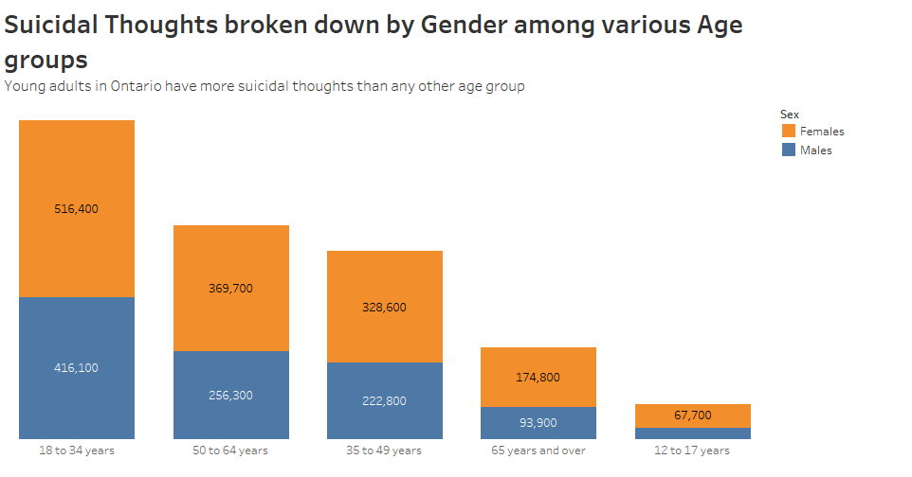
Females in Ontario recorded to have more suicidal thoughts in comparison to males among young adults.
In all the age groups, females constituted for more than 50% of suicidal thoughts.

Slide 10
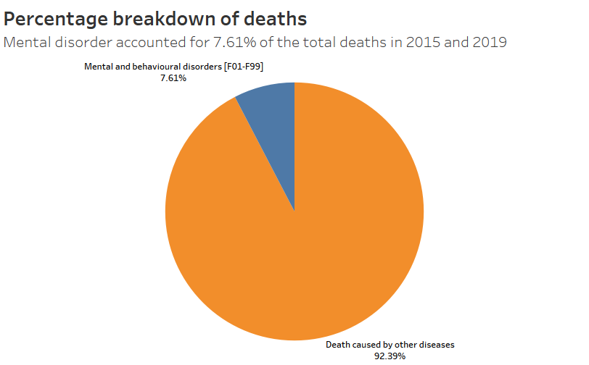
Out of all the deaths in Canada, Mental and behavioral deaths accounted for 7.61%.
Around 45,000 of the total deaths were related to Mental and behavioral disorder.

Slide 11
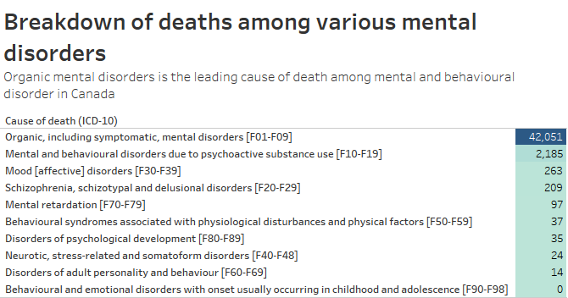
Among all the deaths caused by Mental and behavioral disorders, Organic mental disorders accounted for more than 42,000 deaths in Canada for 2015 and 2019.
The second most prominent cause of death related to mental and behavioral disorder is triggered by psychoactive substance use.

Slide 12
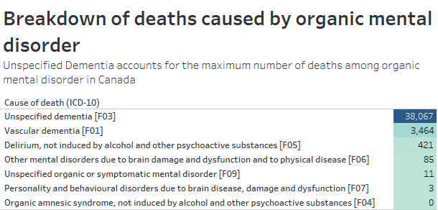
Under organic mental disorders, unspecified dementia caused most deaths in Canada in the years 2015 and 2019.
Vascular dementia was second leading cause of deaths under organic mental disorder, taking more than 3000 deaths.

Slide 13
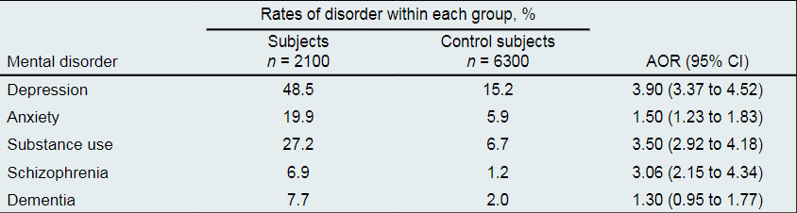
Initial causes of mental disorders leading to suicides
People who suffered from these 5 mental disorders were found to be more likely to die from suicide.
The AOR of people with depression was very high at 3.90.

Slide 14
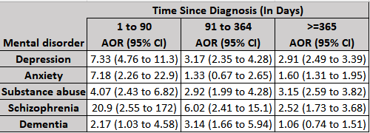
Risk of committing suicide post diagnosis
After the diagnosis of a Mental disorder, the risk of suicide is observed to be maximum between 1 to 90 days of initial diagnosis.
The odds suicide drops as we go above 90 days.
People with Schizophrenia were at the maximum risk of committing suicide.

Slide 15
Results
For the years 2015 and 2019, Ontario recorded the most suicidal thoughts among its citizens.
Among all the age groups, young adults have more suicidal thoughts in Ontario.
Females experience more suicidal thoughts than males in Ontario.
In every age group, females constitute more than 50% of the total count of people having suicidal thoughts.
Around 7.61% of total deaths are caused by mental and behavioral disorders.
Under mental and behavioral disorders, organic mental disorder constitutes to the cause of most number of deaths. Unspecified dementia caused the most number of deaths under organic mental disorder.
People showing early signs of depression are most likely to commit suicide.
People are more likely to commit suicide between 1-90 days after diagnosis.

Slide 16
Conclusion
Significant interprovincial differences exist in Canada.
Female young adults in Ontario have experienced suicidal thoughts the most.
The death rate caused by unspecified dementia is the highest.
The risk of suicide is indirectly proportional to the number of days after diagnosis.
People suffering from early signs of depression are more inclined towards committing suicide.
Better mental health care and its access is essential to reduce the risk of suicide.

Slide 17
Recommendation
Explore interprovincial differences and their impact on mental health care.
Comparisons of these results to more recent administrative data.
Use of a more granular dataset pertaining to a larger timeframe.
Analyze the dependence of suicide on psychosocial factors, relationship between repulsiveness and suicide, etc.

Slide 18
Recommendation
Focus on specific groups of patients identified through the analysis.
Enhance mental health facilities in the provinces with high risk of suicide.
Special attention to patients especially during initial diagnosis.
Conduct mental health awareness programs.

Slide 19
Implications for Business Analytics Managers
Carry out further analysis to identify specific mental health services for women.
Improvise strategies to tackle mental health challenges faced by young adults.
Formulate strategies to prevent death or suicide in patients suffering from unspecified dementia and depression.
Highlight unidentified factors that contribute to suicide.

Slide 20
Limitation
The selected dataset pertains to the year 2015 and 2019.
Extensive quantitative data was not available.
The number of studies available for analysis was also relatively small.

Slide 21
Work Cited
“Deaths, by Cause, Chapter V: Mental and Behavioural Disorders (F00 to F99).” Open Government Portal, https://open.canada.ca/data/en/dataset/1baf70c0-777f-4fb1-8acf-ef787d0400f2.
“Fast Facts about Mental Health and Mental Illness.” CMHA National, 17 Nov. 2021, https://cmha.ca/brochure/fast-facts-about-mental-illness/
“Mental Health Characteristics and Suicidal Thoughts.” Statistics Canada, 6 Aug. 2020, https://www150.statcan.gc.ca/t1/tbl1/en/tv.action?pid=1310009801.
Randall, Jason R., et al. “Acute Risk of Suicide and Suicide Attempts Associated with Recent Diagnosis of Mental Disorders: A Population-Based, Propensity Score—Matched Analysis.” The Canadian Journal of Psychiatry, vol. 59, no. 10, 2014, pp. 531–38. Crossref, https://doi.org/10.1177/070674371405901006.
“Suicide in Canada.” The Canadian Encyclopedia, www.thecanadianencyclopedia.ca/en/article/suicide#:%7E:text=Suicide%20is%20typically%20among%20the,(ranked%2012th)%20in%202020. Accessed 3 Apr. 2022.
Too, Lay San, et al. “The association between mental disorders and suicide: A systematic review and meta-analysis of record linkage studies” https://www.sciencedirect.com/science/article/pii/S0165032719306202

Slide 22
Thank you

